Slide 1

Real Time Face Mask Detection and Social Distance Monitoring
Inhouse Project
Review - II
Project Mentor : Dr. Mrs. Sujata Khedkar
Group Number : 8
Group Members :
Shreyas Kotkar(D12C-34) Leader
Yashkumar Jain(D12B-24)
Vikram Virwani(D12B-68)
Chirag Kinger(D12C-31)

Slide 2
Content
Introduction to Project
Lacuna in the existing System
Problem Statement
Literature Survey
Hardware, Software, tools and the constraints
Block Diagram of the Project (Conceptual Architecture)
Modular Diagram of the Project (Also DFD, Use Case diagram / ER Diagram)
Methodology employed
Algorithms Implemented
Implementation Details (Flowchart, GUI Screenshots, Dataset Used)
Results Obtained (Screenshots)
Evaluation Measures
Future Scope
Conclusion
References
Review Sheet 1 & 2
Details of paper Published

Slide 3
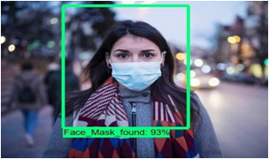
Introduction to Project
Vikram Virwani D12B-68
❖COVID-19 is an emerging infectious disease.
❖Approach to preventing the spread of the virus.
❖ Facemask-wearing is valuable.
❖Facemask-wearing provide an opportunity for automatic identification.
❖Machine learning has presented opportunities for development

Slide 4
Lacuna in the existing system
Vikram Virwani D12B-68
❖There is no such system available in India to be used in school or college campuses or public places.
❖All the existing system are either face mask detector or social distancing manager but our model is combination of both.

Slide 5
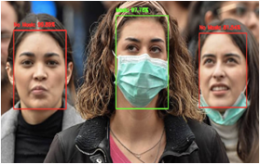
Problem Statement
Vikram Virwani D12B-68
❖To build a system that can detect and
identify if the detected faces are wearing
masks or not.
❖Real-world videos are entirely different from
the videos captured by webcams or selfie cameras.
❖Our model can detect faces and classify masked faces
from unmasked ones.

Slide 6
Literature Survey
Yashkumar Jain D12B-24
Sr. No. | Title | Algorithm Used | Year
1 | Face Mask Detector with OpenCV, Keras/TensorFlow, and Deep Learning by Adrian Rosebrock | OpenCV and Keras/TensorFlow and Deep Learning | 05-2020
2 | A Vision-based Social Distancing and Critical Density Detection System for COVID-19 | AI, machine learning and computer vision | 07 - 2020
3 | Algorithm for Face Detection Combining Geometry Constraints and Face-Mask | combines geometry constraints and face-mask | 06 - 2013
4 | Face Recognition with Facial Mask Application and Neural Networks | DCT, MLP and RBF Neural Network | 06-2013
5 | Enabling and Emerging Technologies for Social Distancing: A Comprehensive Survey | AI, machine learning, computer vision, ultrasonic etc. | 05-2020

Slide 7
Literature Survey
Yashkumar Jain D12B-24
Sr. No. | Title | Algorithm Used | Year
6 | Face Mask Detection using Transfer Learning of InceptionV3 | RCNN, SSD, YOLO | 07-2020
7 | A Review on Face Mask Detection using Convolutional Neural Network | MobileNet V2 classifier, SVM, PCA | 11-2020
8 | Applying deep learning algorithm to maintain social distance in public place through drone technology | YOLO-v3, Darknet-53 | 05-2020
9 | Deep Learning based Safe Social Distancing and Face Mask Detection in Public Areas for COVID-19 Safety Guidelines Adherence | RCNN, MobileNet V2 classifier, SSD, YOLO-v3, Computer Vision | 12-2020
10 | Real-Time Face Mask Identification Using Facemask Net Deep Learning Network | Facemask Net, ReLu | 07-2020

Slide 8
Hardware, Software, Tools & constraints
Chirag Kinger D12C-31
❖SOFTWARE : Jupyter Notebook + Python 3.x (3.8 or earlier)
❖EDITOR : VS Code/ PyCharm/ Sublime/ Spyder
Implementing our COVID-19 face mask detector training script with Keras and TensorFlow.
To accomplish this task, we'll be fine-tuning the MobileNet V2 architecture.
❖HARDWARE:
GPU : Graphics Processor (NVIDIA) min 2GB
Camera : CCTV/ Webcam/ Mobile Camera
Storage Disk : SSD - Min 400MB/s Read Speed

Slide 9
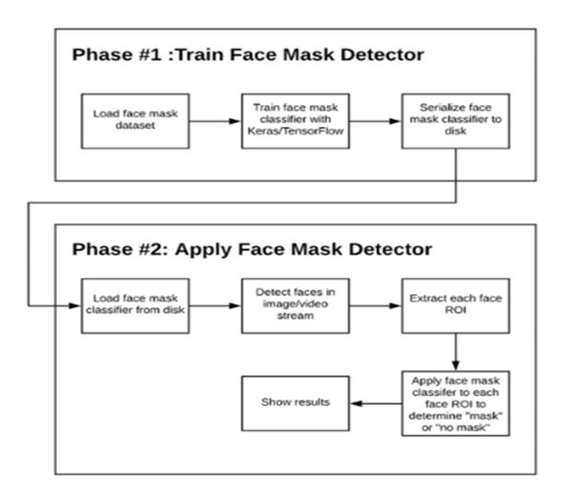
Block Diagram of the Project (Face Mask Detector)
Chirag Kinger D12C-31

Slide 10
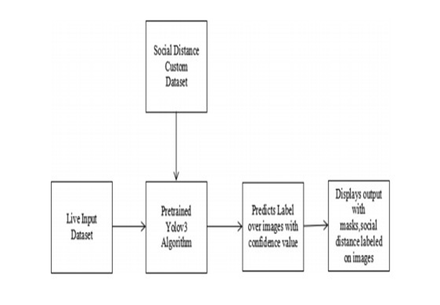
Block Diagram of the Project (Social Distance Detector)
Chirag Kinger D12C-31

Slide 11
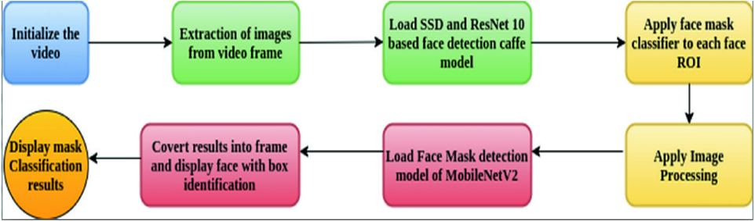
Modular Diagram of the Project
Chirag Kinger D12C-31

Slide 12
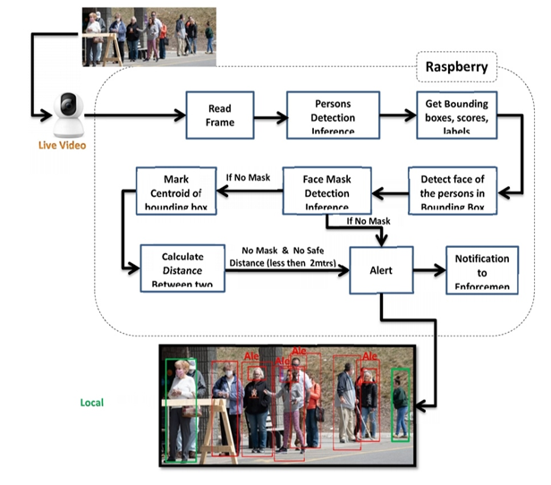
Methodology Employed
Shreyas Kotkar D12C-34

Slide 13
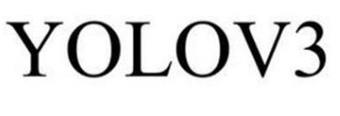



Algorithms Implemented
Shreyas Kotkar D12C-34

Slide 14

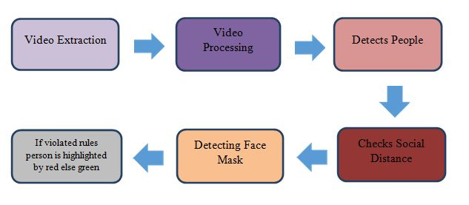
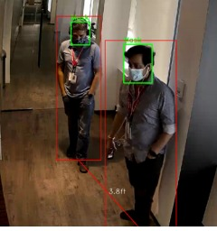
Implementation Details
Shreyas Kotkar D12C-34
Data set used for face mask is created by Prajna Bhandary, the data set consist of 1376 images belonging with mask and without mask.

Slide 15
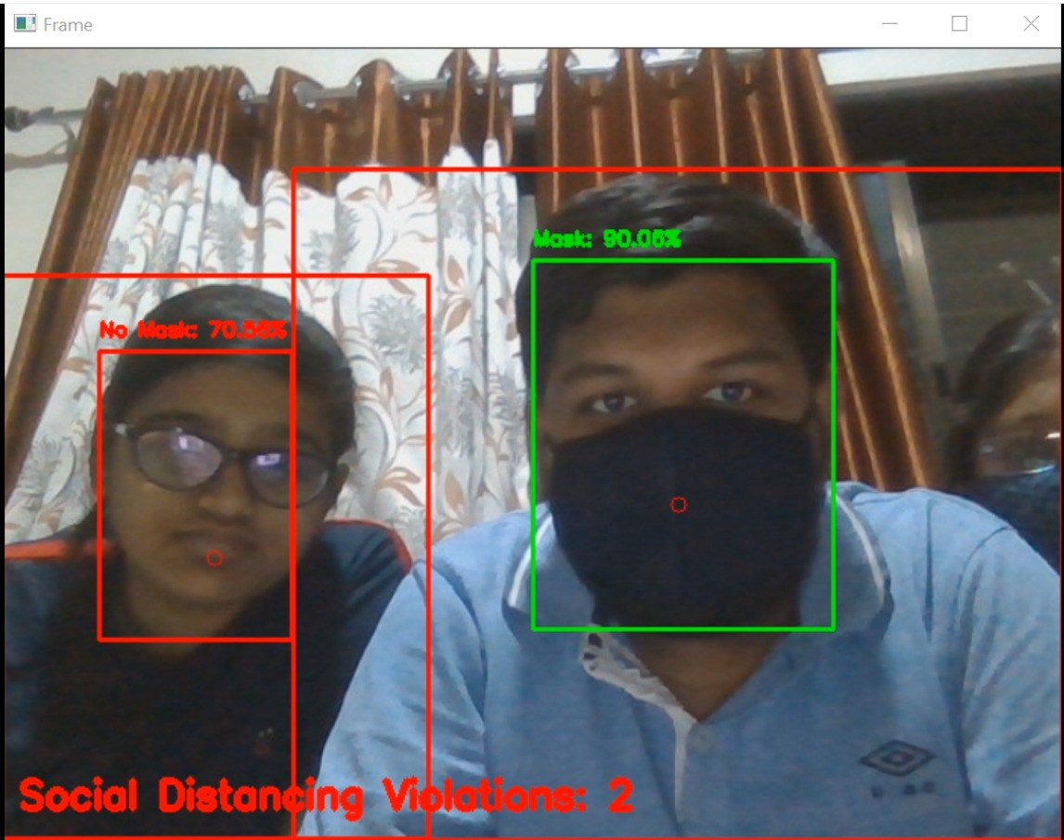
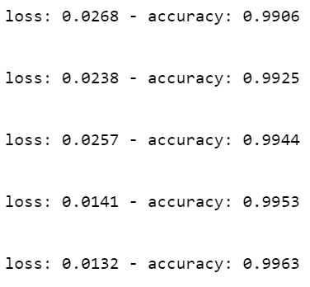
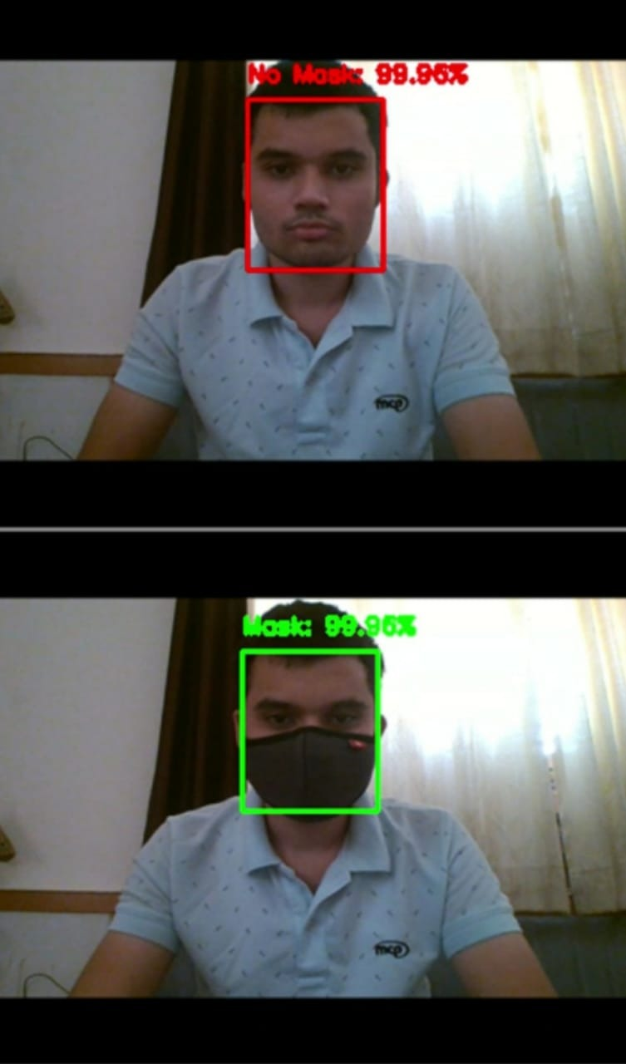
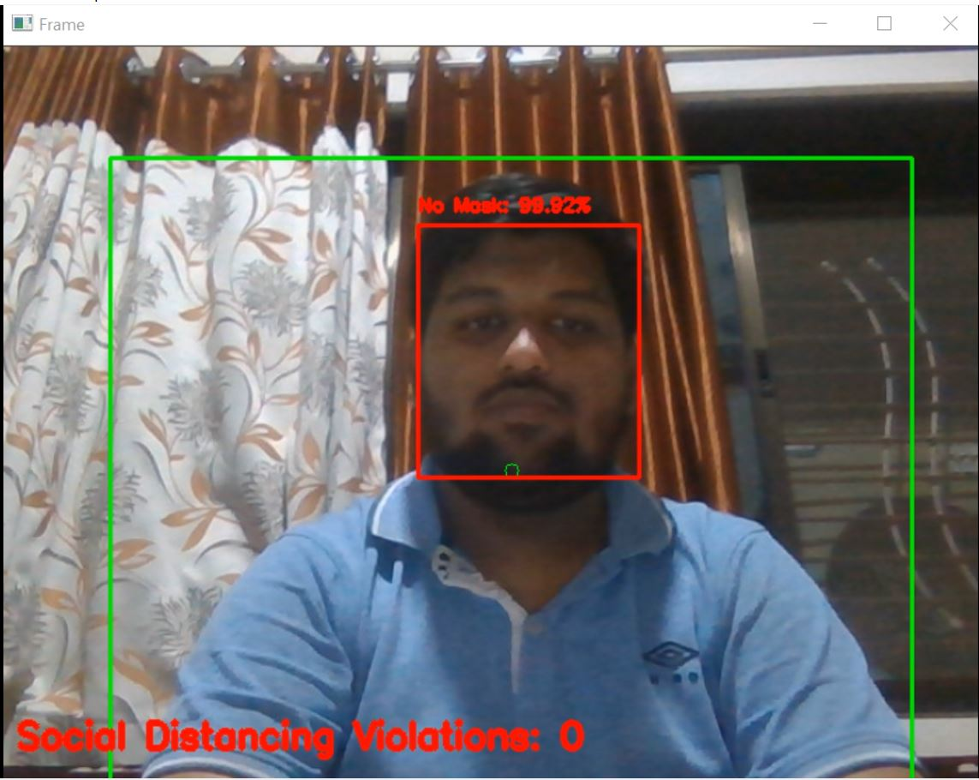
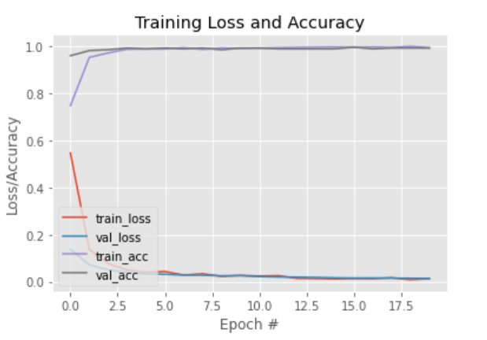
Results Obtained (Screenshots)
Yashkumar Jain D12B-24

Slide 16
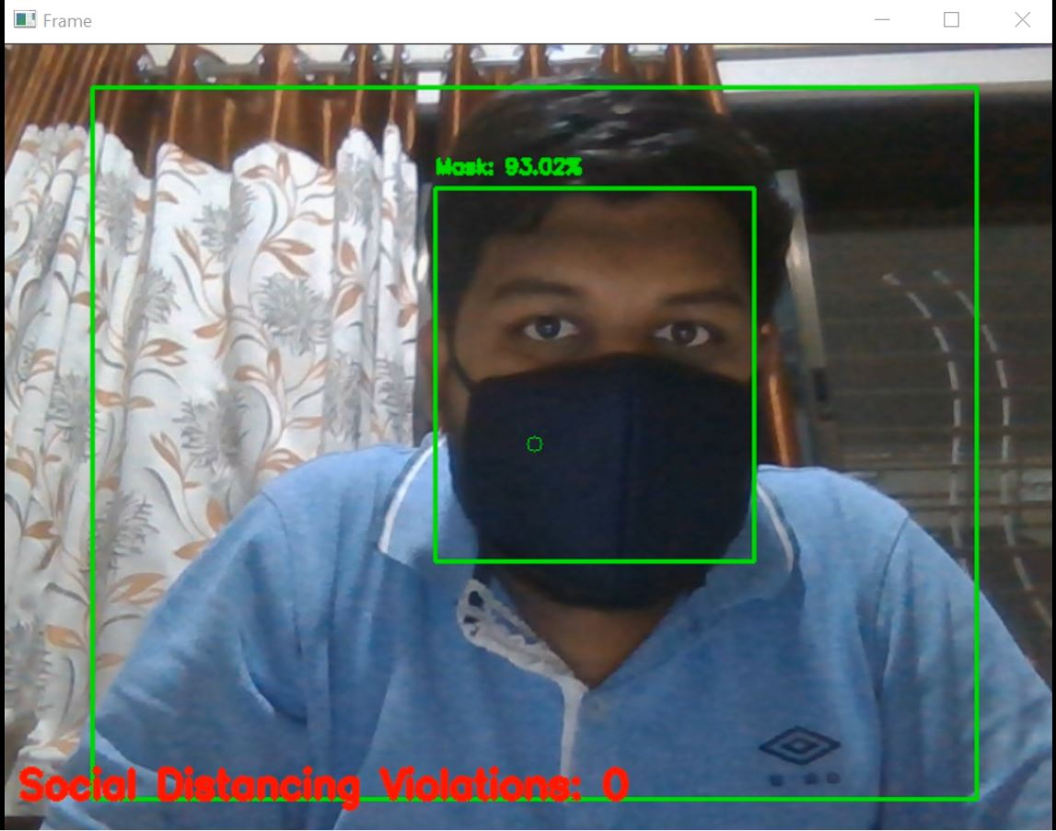
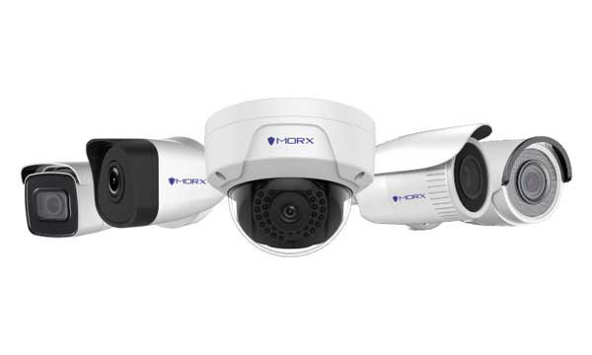
Evaluation Measures
Yashkumar Jain D12B-24
Software part is successfully implemented as we can classify if a person or a group in the frame is wearing mask or not and also if they are maintaining social distancing or not.
We have trained our model successfully and got a 99% accuracy in detecting face mask of a person or a group in the frame and also monitoring social distancing.

Slide 17
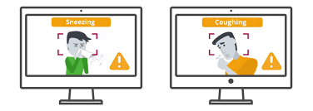
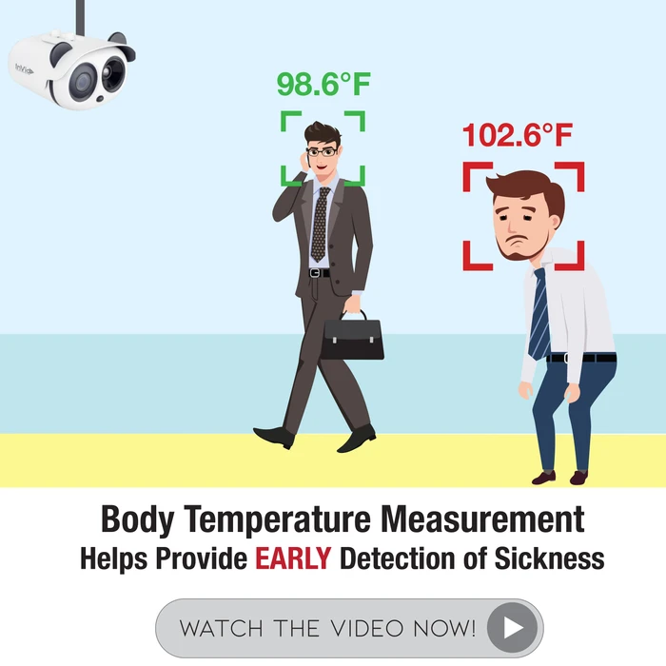
Future Scope
Vikram Virwani D12B - 68
Coughing and Sneezing Detection :-
Temperature Screening :-

Slide 18
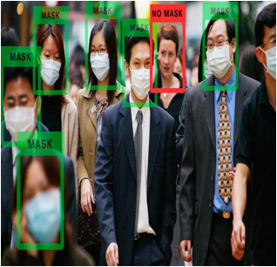
Conclusion
Yashkumar Jain D12B-24
System will operate in an efficient manner in the
current situation when the lockout is eased and
helps to track public places.
System would improve public safety.
❖ Prevention of epidemic diseases including
COVID-19 in public.

Slide 19
References
●P. Viola and M. Jones, “Rapid object detection using a boosted cascade of simple features,” in Proceedings of the 2001 IEEE computer society conference on computer vision and pattern recognition. CVPR 2001, vol.1. IEEE, 2001, pp. I–I.
●R. Girshick, J. Donahue, T. Darrell, and J. Malik, “Rich feature hierarchies for accurate object detection and semantic segmentation,” in Proceedings of the IEEE conference on computer vision and pattern recognition,2014, pp. 580–587.
●R. Girshick, “Fast r-cnn,” in Proceedings of the IEEE international conference on computer vision, 2015,pp. 1440–1448.
●S. Ren, K. He, R. Girshick, and J. Sun, “Faster r-cnn: Towards real-time object detection with region proposal networks,” in Advances in neural information processing systems, 2015, pp. 91–99.
●W. Liu, D. Anguelov, D. Erhan, C. Szegedy, S. Reed, C.-Y. Fu, and A. C. Berg, “Ssd: Single shot multibox detector,” in European conference on computer vision. Springer, 2016, pp. 21–37.
● J. Redmon, S. Divvala, R. Girshick, and A. Farhadi, “You only look once: Uniﬁed, real-time object detection,” in Proceedings of the IEEE conference on computer vision and pattern recognition, 2016, pp. 779–788.

Slide 20
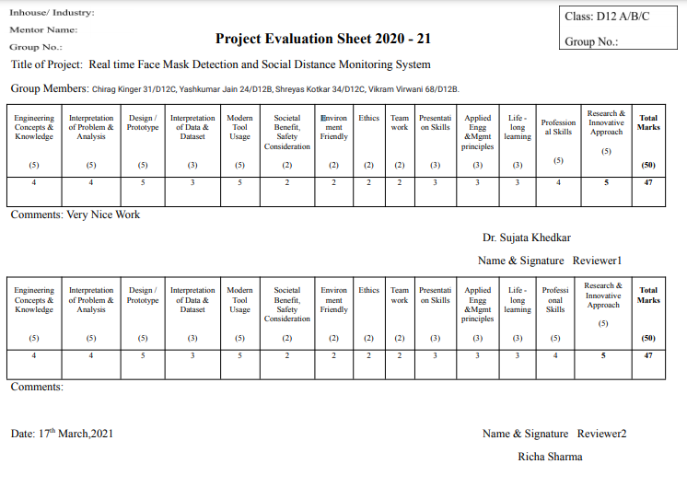
Review Sheet 1

Slide 21
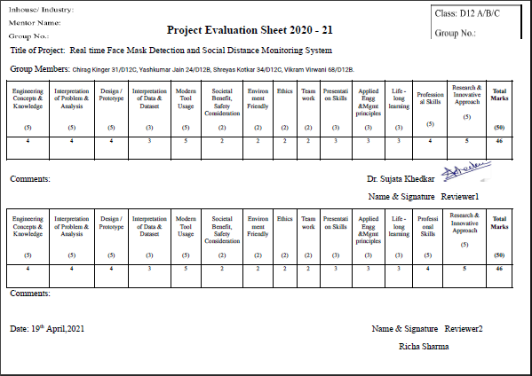
Review Sheet 2

Slide 22
Details of Paper Published
Paper Link :-
https://drive.google.com/file/d/1Nwa4MFuckloyqefDfitj9Rhgzbpr6Hyd/view?usp=sharing
Video Link :-
https://youtu.be/sFxxMk4IDrs

Slide 23
Thank You!!

